Slide 1

FINAL PROJECT PRESENTATION
BATCH : JANUARY 2020
USA STOCK MARKET PREDICTION USING FINANCIAL FUNDAMENTAL DATA
Members -
Alok Jha
Ashish Kumar Prasad
Charu Sharma
Shriya Mathur
Group 6
Mentor - Ms. Akhila Gurre
(Olympus Group:15)

Slide 2

PROJECT SYNOPSIS
PROBLEM STATEMENT
To predict the stock price change based on the financial data
of the previous year.
For each stock, if the CLASS = 1. From a trading perspective, the 1 identifies those stocks that hypothetically, a trader should BUY at the start of the year and sell at the end of the year for a profit.
For each stock, if the CLASS = 0. From a trading perspective, the 0 identifies those stocks that hypothetically, a trader should NOT BUY, since their value will decrease that indicates a loss of capital.
PROJECT OUTCOME
The aim of the project is to efficiently analyse and predict whether an investor should buy a stock or not. Therefore, we are trying to build a model with more than 200+ financial indicators of a company in order to make informed investment decisions by the investors with ease. This would specially empower the small investor which can’t afford extensive research. This would automate the whole investing process which currently is very research intensive or rely on heuristics as mentioned above.

Slide 3
DATA INFORMATION
Dataset contains 200+ financial indicator features, that are commonly found in the 10-K filings each publicly traded company releases yearly, for a alot of US stocks (on average, 4000 stocks are listed in each year dataset). We have 5 years of data (2014-2018). So total of 20,000 rows (approx).
Features of the dataset includes information present in BALANCE SHEET, CASH FLOW and INCOME STATEMENT. Some of the features are:-
EBITDA
Total Assets
Operating Cash Flow
P/E Ratio
Cash Ratio
Interest Coverage Ratio

Slide 4
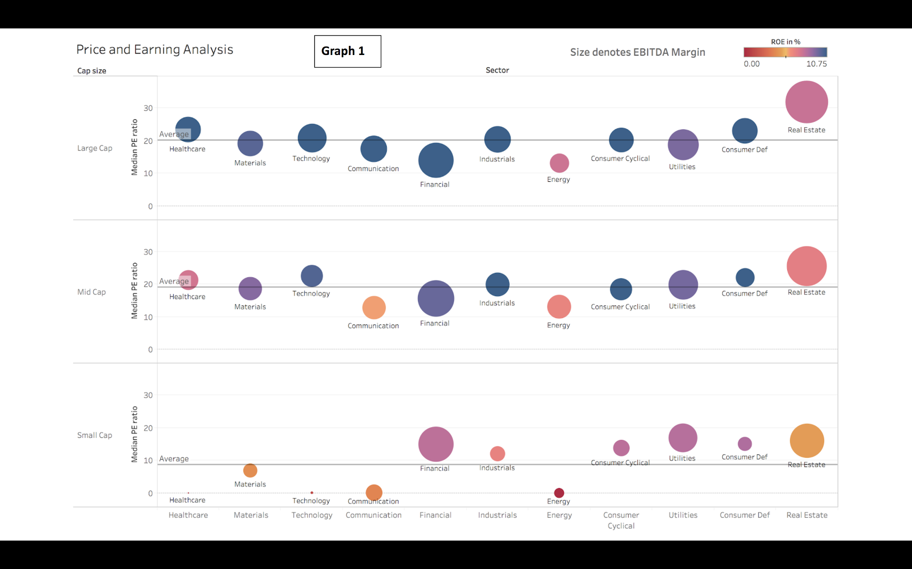
EXPLORATORY DATA ANALYSIS
Analysing average profitability of sectors across different cap size(Indicated by ROE & EBITDA Margin)
Analysing undervaluation or overvaluation of a sector across different cap size(by P/E ratio)
INFERENCES :
LARGE CAP STOCKS
In large cap, the majority of the sectors are Blue indicating that Return on equity is high for these stocks. Therefore the investors are also buying these stocks more and driving it’s P/E ratio high in comparison to small cap stocks.
Due to this high ROE on average, These large cap stocks are also referred to as Blue chip stocks
SMALL CAP STOCKS
Across sectors, there is more variability in the small cap sector . This indicates that the level of uncertainty is more in small companies since they are in the growth stage and still figuring out their business model/niche.
Sector and Cap Size Govern the Dynamic
Price and Earning Analysis

Slide 5
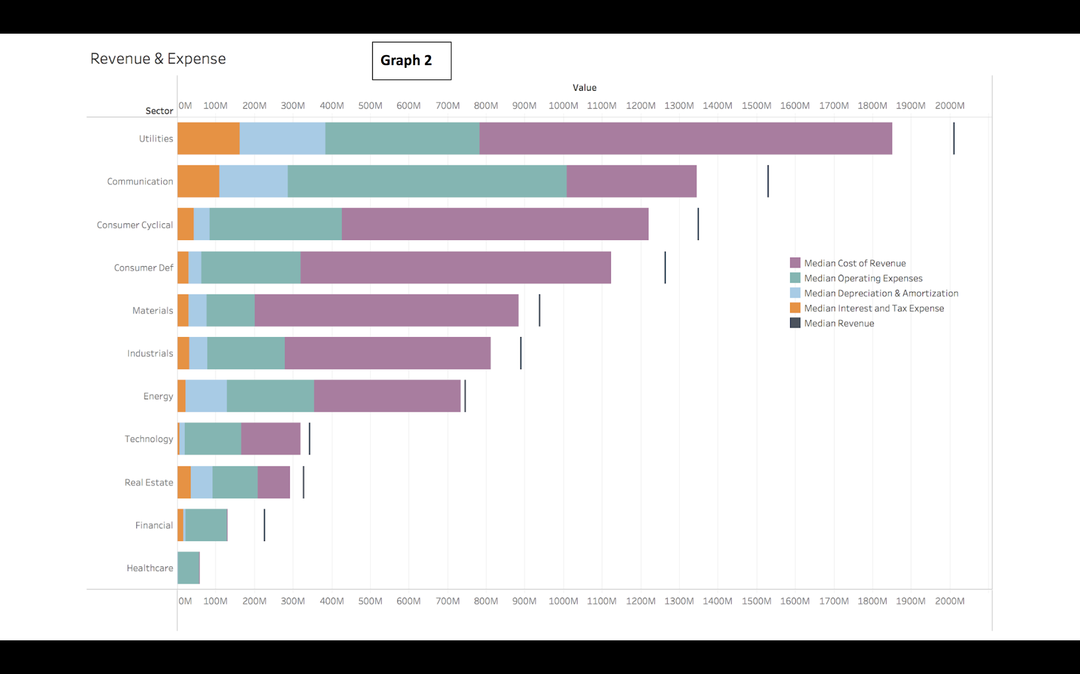
There are 4 major type of Expenses -
COST OF REVENUE: It represents the direct costs associated with the goods and services provided
OPERATING EXPENSE: It refers to expenditures that are not directly tied to the production of goods or services, such as rent, utilities, office supplies, marketing & R&D
DEPRECIATION & AMORTIZATION: Depreciation represents the cost of capital assets on the balance sheet being used over time, and amortization is the similar cost of using intangible assets.
INTEREST & INCOME TAX EXPENSE: Interest expense relates to the cost of borrowing money.
INFERENCES
Some sectors are more capital intensive then other. Therefore various metrics like total debt, working capital will be highly sector dependent.
The proportion of different type of expenses varies across the sector due to different dynamics and this could be used as a anomaly detector to figure out the companies that is not following the overall trend of expense in their sector
REVENUE & EXPENSE

Slide 6
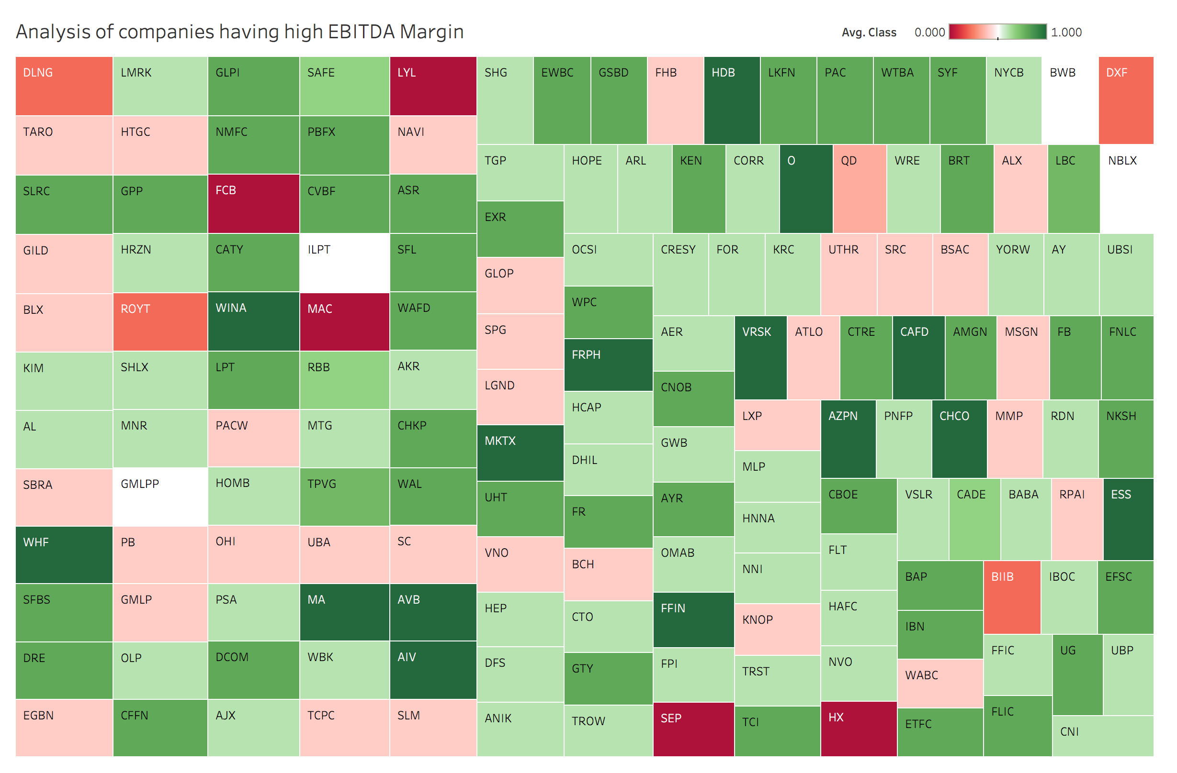
IDENTIFYING IMPORTANT DISCRIMINATING FACTOR BY ANALYZING COMPANIES HAVING HIGH EBITDA MARGIN
Here we are doing exploratory analysis by seeing only those companies that have high EBITDA Margin (15-60%) .
Intuitively, Mostly the companies belonging here have class 1(green color)
But the idea behind making this graph is to individually analyze the companies which belong to class 0 in spite of having a high EBITDA Margin. In the process of finding the reason why these companies belong to class 0. We would discover other variables that are important along with EBITDA Margin
INFERENCES
There are two major reason because of which the companies belong to class 0 in spite of having high EBITDA Margin
Low Current Ratio: The current ratio is a liquidity ratio that measures a company's ability to pay short-term obligations . Low values indicates the weak financial stability due to insufficient cash
High P/E ratio: generally indicates that the stock has become over valued therefore due to market correction, it’s share price has decreased
High P/E Ratio (81)
Note
Class 0: Stocks which share price has decreased in the following year
Class 1: Stocks which share price have increased in the following year
EBITDA: Earnings before interest, taxes, depreciation and amortization
Low current ratio (0.6)

Slide 7
INFERENCES
Based on exploratory data analysis done till now-
We conclude that sector and Cap size(Large, mid, small) are important categories that govern the
dynamics of a company.
Therefore,on analysis of which factors discriminate between class 0 & 1, we should see it
separately for each sector and cap size.
There are 200+ features in this dataset, We will visualize the discriminating power across class for the 4 most important factors:-
REVENUE(SALES) - Indicates if there is demand for the product company is offering
EBITDA- Indicates if business model of the company is profitable
OPERATING CASH FLOW- Indicates financial stability of the company
MARKET CAPITALIZATION- Indicates how much the market values the company. This indicates current health as well as expectation of future health
These four factors are identified based on the exploratory analysis done till now
So therefore in the next analysis we would see the discriminating power of these factors across class for each sector and cap size.

Slide 8
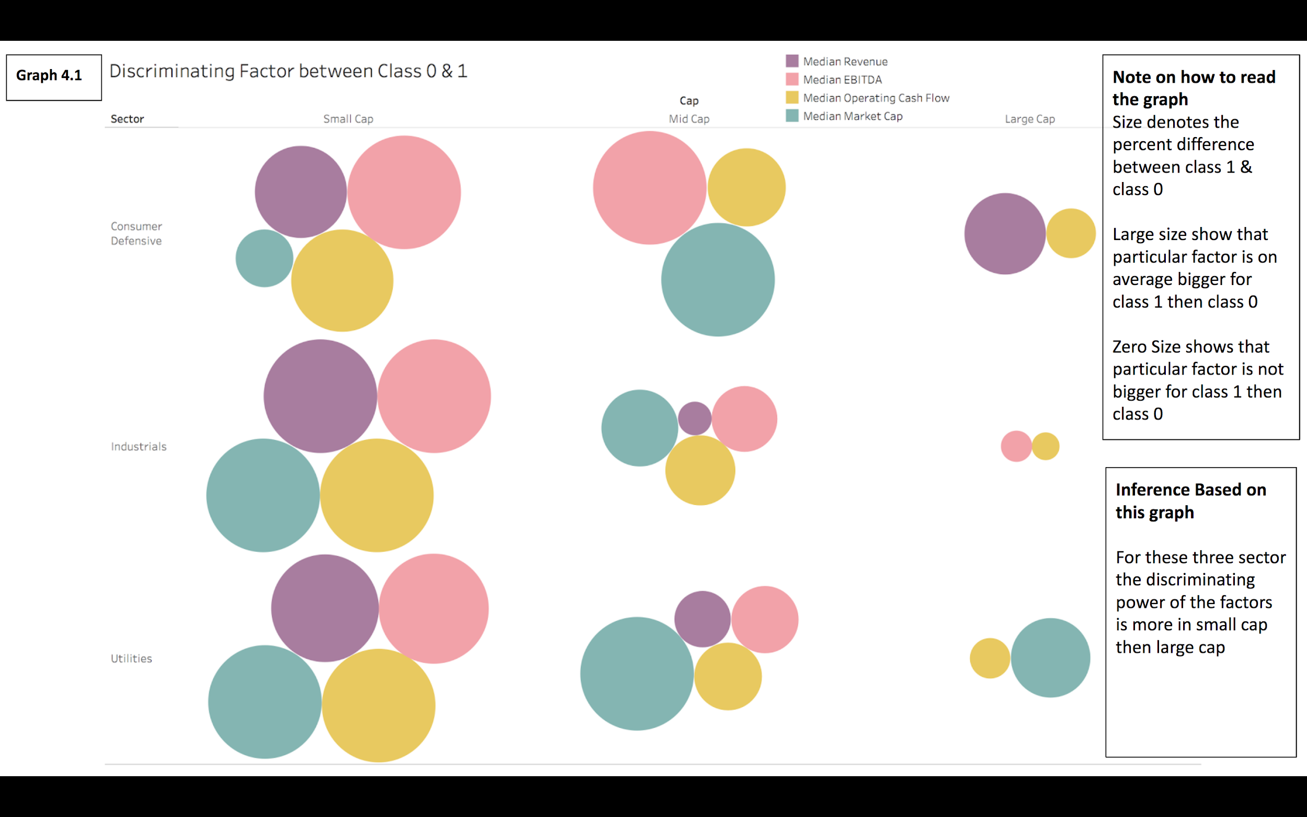
FOR : CONSUMER DEFENSIVE,
INDUSTRIALS & UTILITIES SECTORS

Slide 9
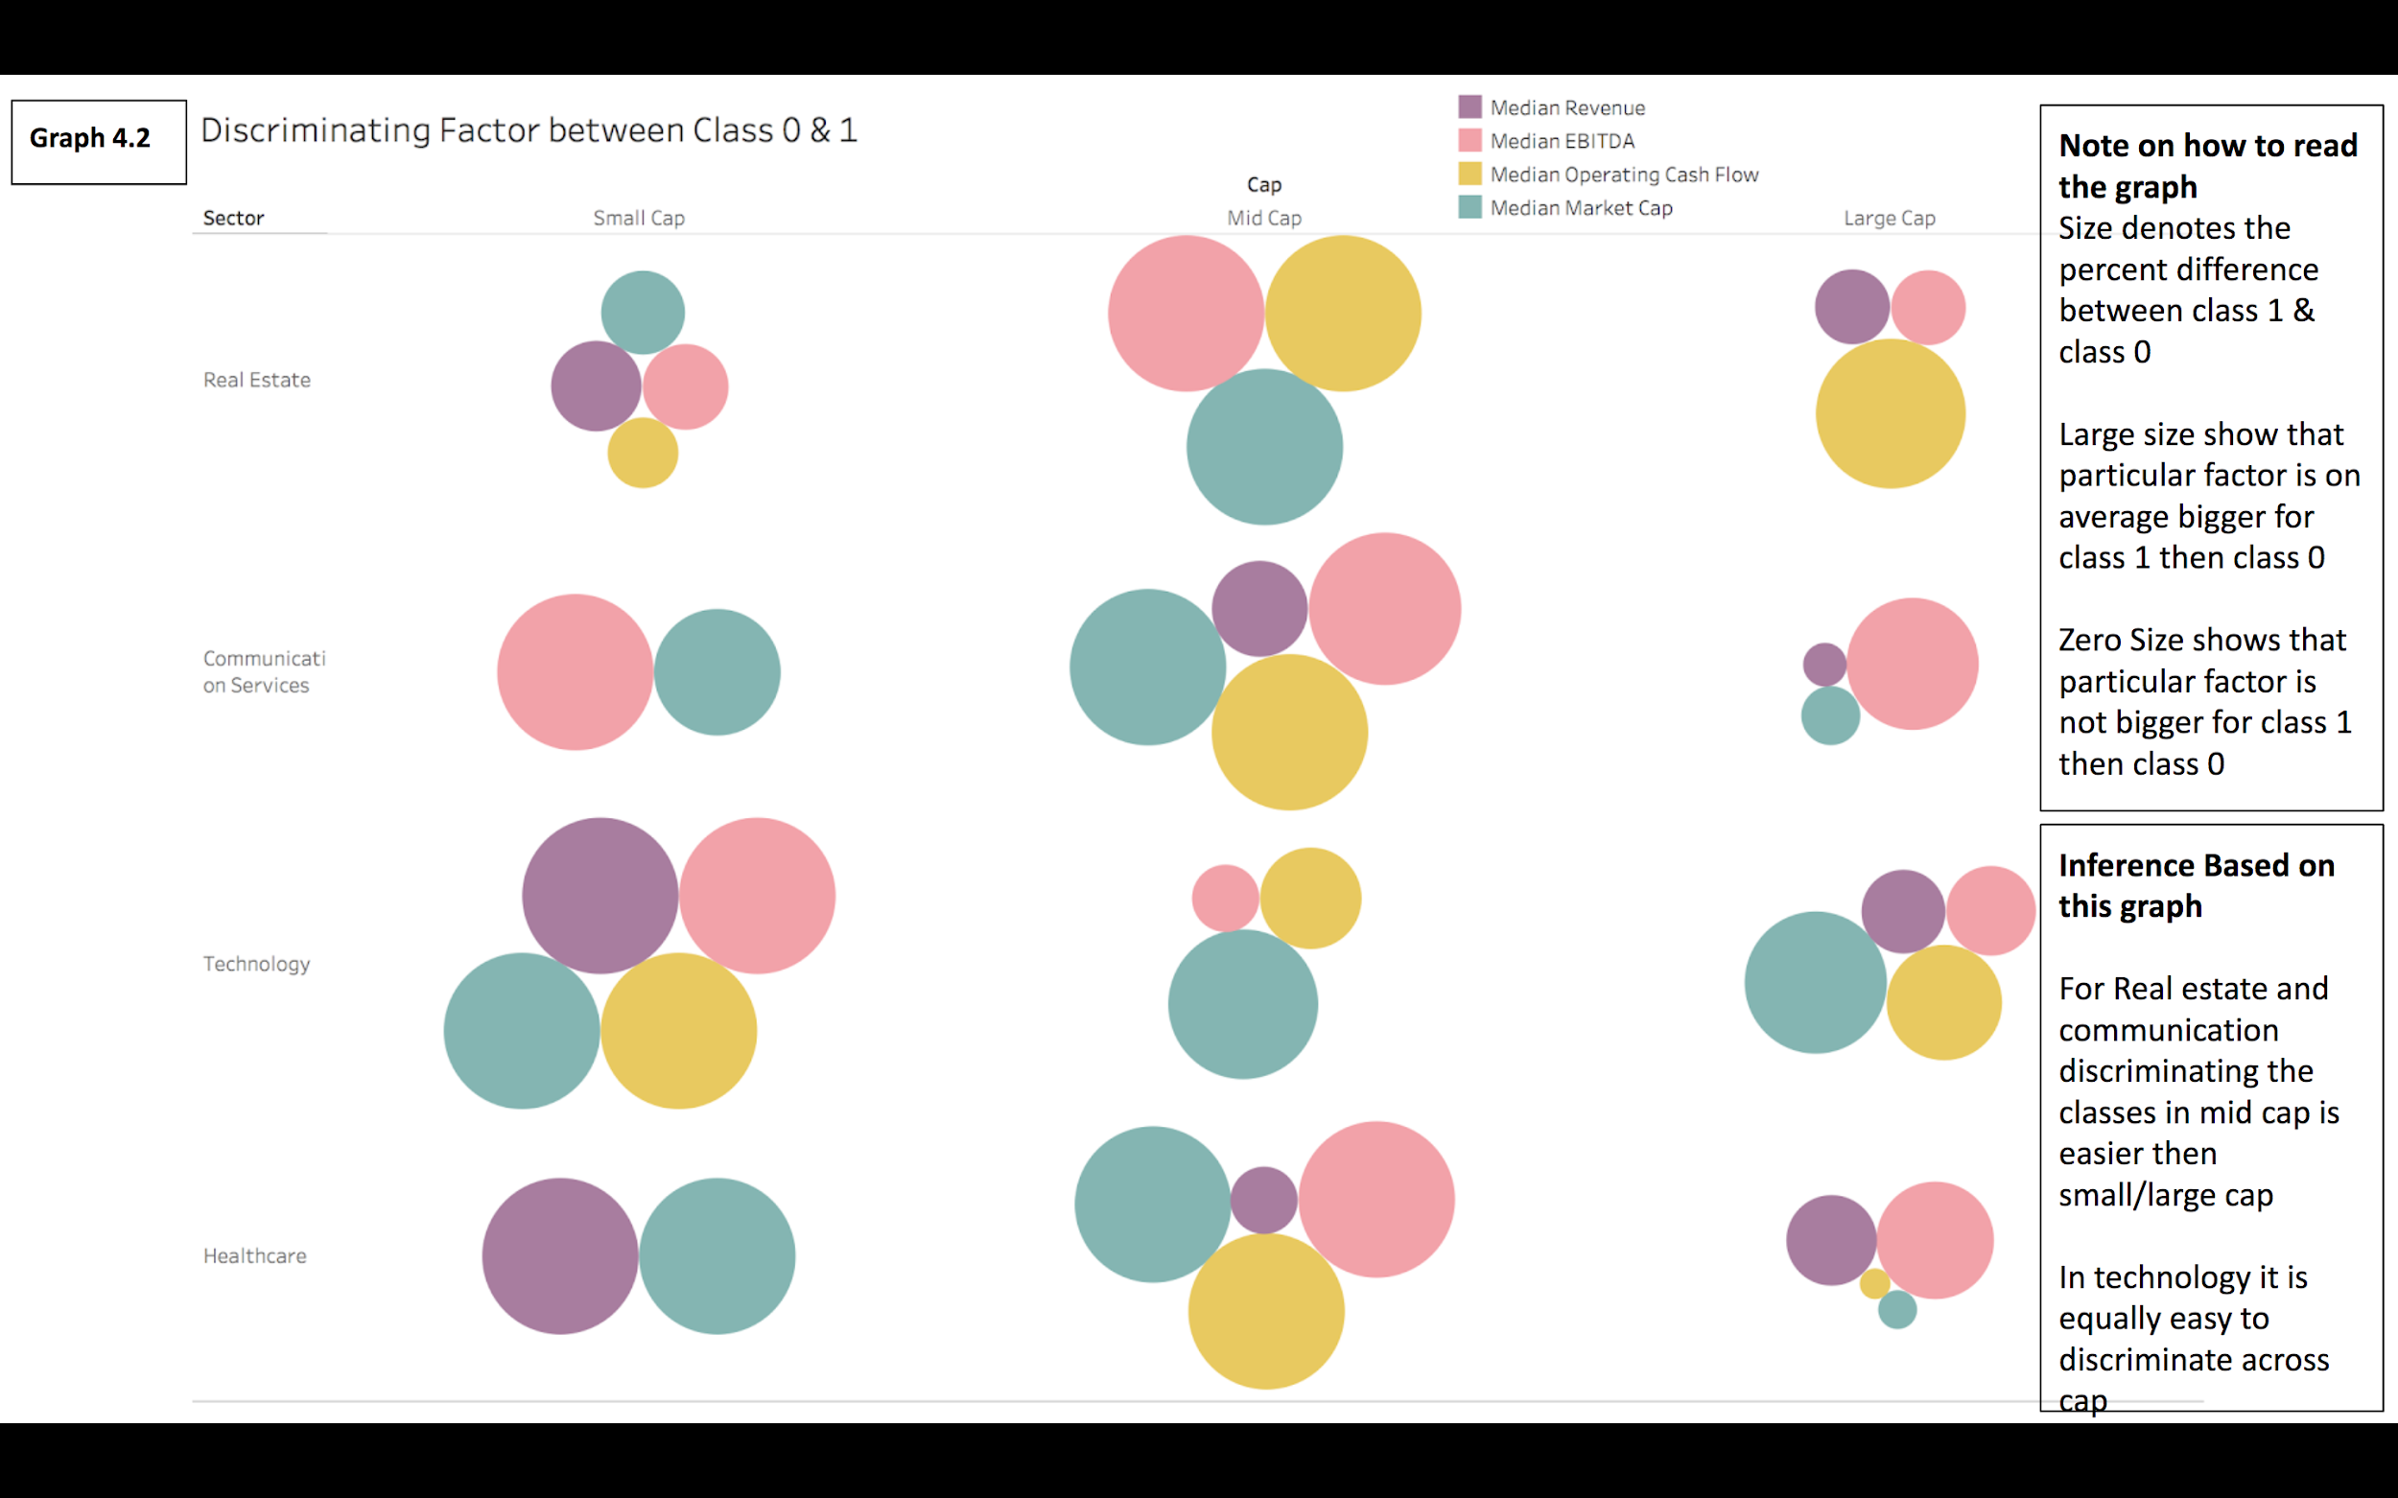
FOR : REAL ESTATE, COMMUNICATION SERVICES,
TECHNOLOGY & HEALTHCARE SECTORS

Slide 10
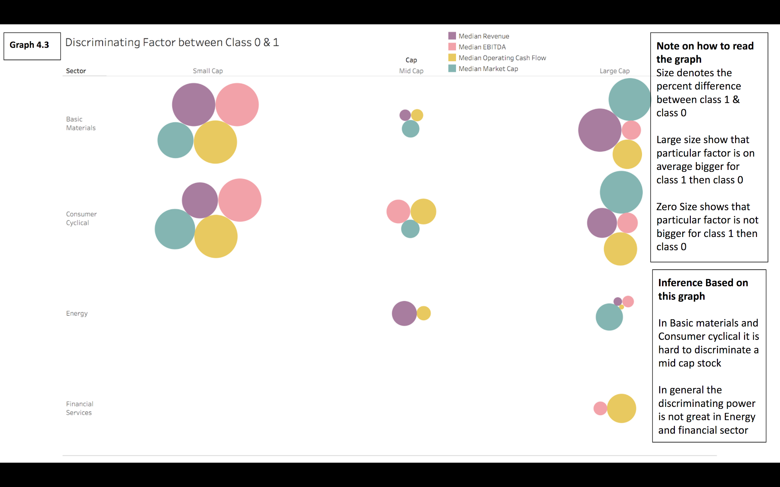
FOR : BASIC MATERIALS, CONSUMER CYCLICAL,
ENERGY & FINANCIAL SERVICES SECTORS

Slide 11
DATA PRE-PROCESSING
DATA CLEANING
OUTLIER TREATMENT
FEATURE ENGINEERING
DATA TRANSFORMATION

Slide 12
Data Cleaning
We removed the unwanted columns that were semantically similar to other columns.We also removed columns which had very low variance.
In this process we were able to reduce the no of columns from 225 to 181.
On web scraping the missing data, we found 50 column detail for most of the companies that were missing.
For the remaining 131 columns (181-50) we calculated its value based on the exact formula For eg :-
Book Value per Share =Total asset-total liabilities / Weighted Average Shs Out (Dil)
Total asset, total liabilities and Weighted Average Shs Out (Dil) were given in those 50
columns and accordingly we calculated the Book value per share
Remaining missing values were then imputed with KNN Imputer.
After this step, there were 20,794 rows & 181 columns

Slide 13
2. Outlier Treatment
2.1 Removing outliers using pyOD
What is pyOD?
PyOD is an open-source Python toolbox for performing scalable outlier detection on multivariate data. It provides access to a wide range of outlier detection algorithms, including well established outlier ensembles
How are we using pyOD ?
We would be aggregating the result of seven different outlier detection algorithms in pyOD, So that the outliers detected are more robust to mistakes made by any one algorithm.
Outlier fraction of 0.1 is used in each method as a threshold to decide the number of outliers.
Angle-based Outlier Detection (ABOD), Cluster-based Local Outlier Factor (CBLOF), Feature Bagging, Histogram-based Outlier Detection (HBOS), Isolation Forest, KNN, Average KNN have been taken into account.
Final result after their application:
We removed 870 companies in which at least 5 out of 7 methods depicted that the corresponding company is an outlier.
The outlier companies removed corresponds to approximately 4% of the total companies.
2.2 Replacing the outlier by upper or lower cap
After removing the outliers using the above methods,we would be capping all the remaining outliers beyond the 0.1 and 0.9 percentile value with corresponding lower or upper cap.

Slide 14
3. Feature Engineering
3.1 Statistical Analysis - To identify similar input columns
Applying pearson correlation between all the possible combination of numerical input columns
Identifying the pair of input columns which have more than 0.9 correlation
The columns we removed through the above process were in sync with our domain knowledge.
Based on this analysis, we were able to remove 25 columns
Note: Now we have 154 columns

Slide 15
FEATURE SELECTION - To Identify Least Important Features
NOTE-
In each of the 4 methods the top 90 out of 150 columns were selected
To make this robust to the mistake made by any one of the models, We identified the least important column which was not selected by at least 3 out of the 4 methods.
Final result
On combining the result obtained from the above method with domain knowledge, We were able to remove 10 more columns.
Note: Now we have 144 columns
Univariate Feature Selection
We compare each feature to the target variable(Class), to see whether there is any statistically significant relationship between them
We are using two different univariate feature selection method- f test and mutual information classification test
Recursive feature elimination using models
Compared to univariate feature selection, model-based feature selection consider all feature at once, thus can capture interactions.
We are using two different models- Logistic Regression and Random Forest Classifier as a recursive feature selector

Slide 16
DATA TRANSFORMATION
4.
4.1 Binning the numerical features
First we identified the columns which denoted growth. There were 15 such columns.These columns were binned at 5 levels.
4.2 One hot encoding the categorical features
Only Sector columns were one hot encoded
4.3 Scaling and Normalisation
All the numerical features were scaled using Standard Scaler

Slide 17
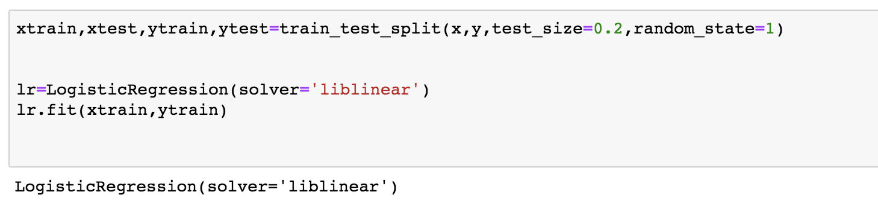
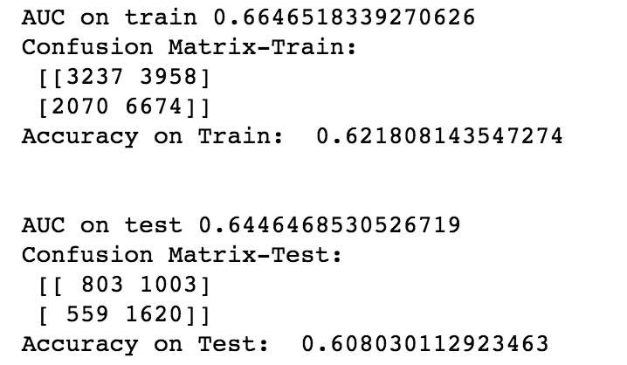
Base Model Training

Slide 18
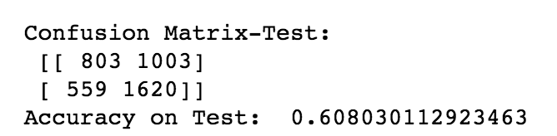
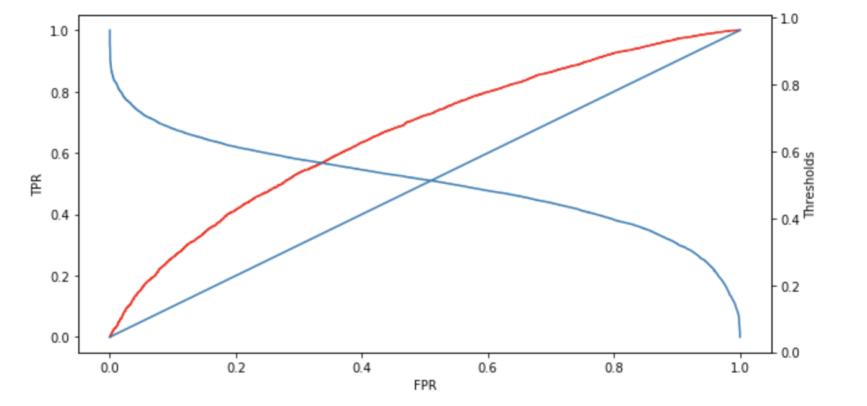
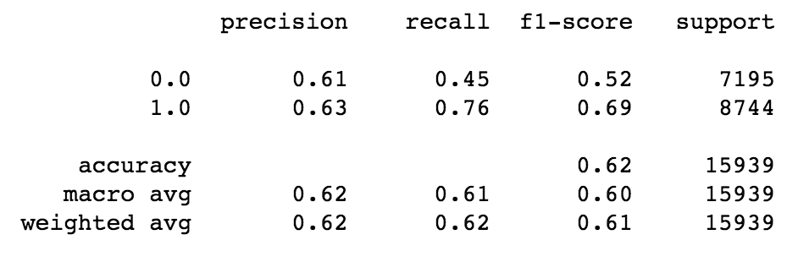
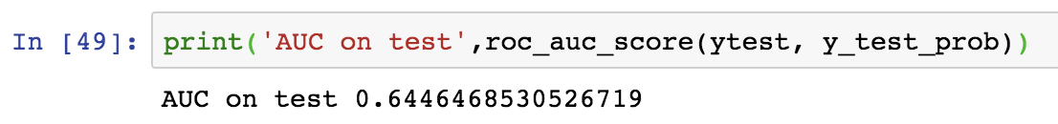
Base Model- Performance on Test Data
Threshold is 0.5

Slide 19
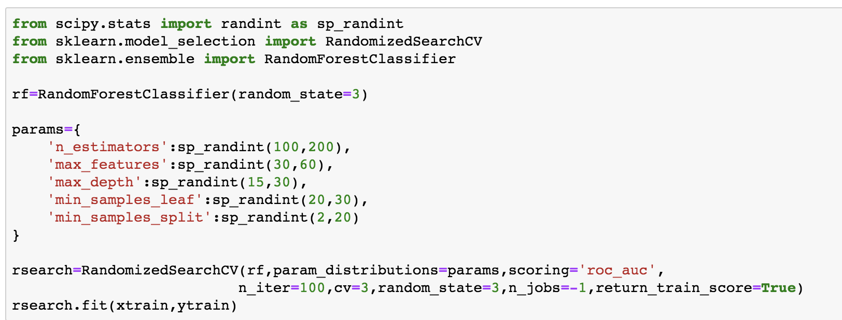
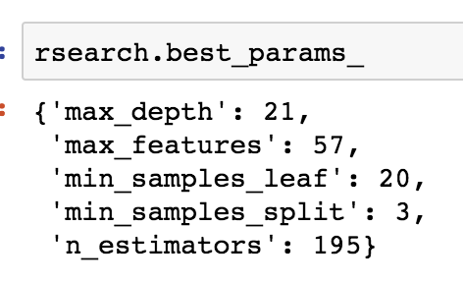
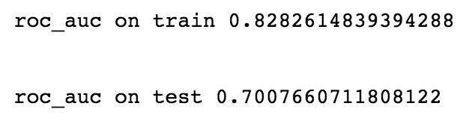
Random Forest Classifier Model Training

Slide 20
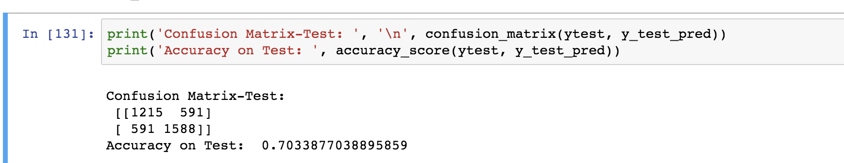
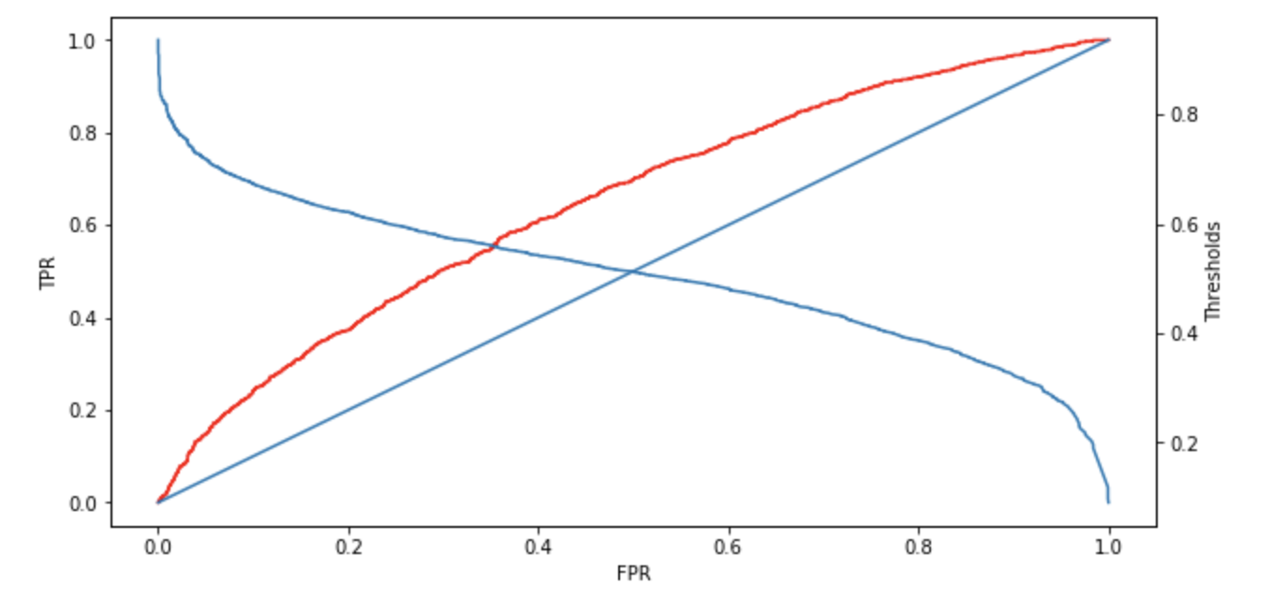
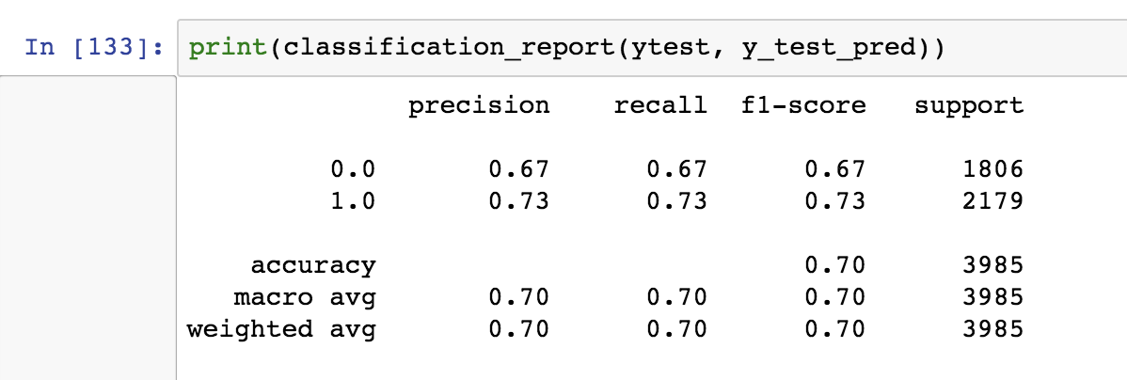
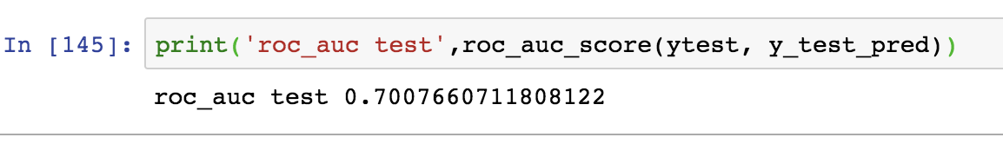
Random Forest Classifier- Performance on Test Data
Threshold is 0.5

Slide 21
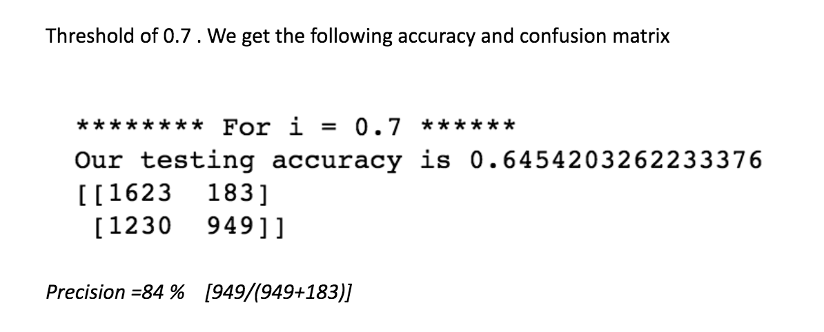
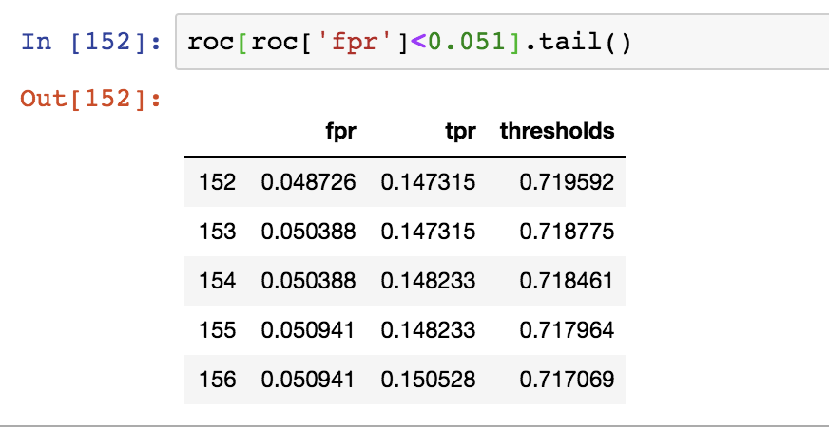
Precision & Recall Tradeoff
Our problem is to pick the stocks that belong to class 1. In the process of doing so if we classify some stocks which belong to class 1 as a class 0 Then this won’t be so detrimental since it won’t result in any loss of money. It is a missed opportunity but from a investor perspective we only want to identify few stocks which will surely increase rather than predicting all the stocks correctly
On the contrary , if we classify a stock belonging to class 0 as class 1. Then this would lead to loss of money as we would invest in a stock which share price decreases. Hence it is a more detrimental problem.
Therefore in this context, we are more interested in decreasing our false positive rate and ready to accept the trade off of True positive rate decreasing. The main metric that we would optimise is the precision of model
Therefore we chose a threshold of 0.7 as shown in adjacent figure
For Random Forest Classifier

Slide 22
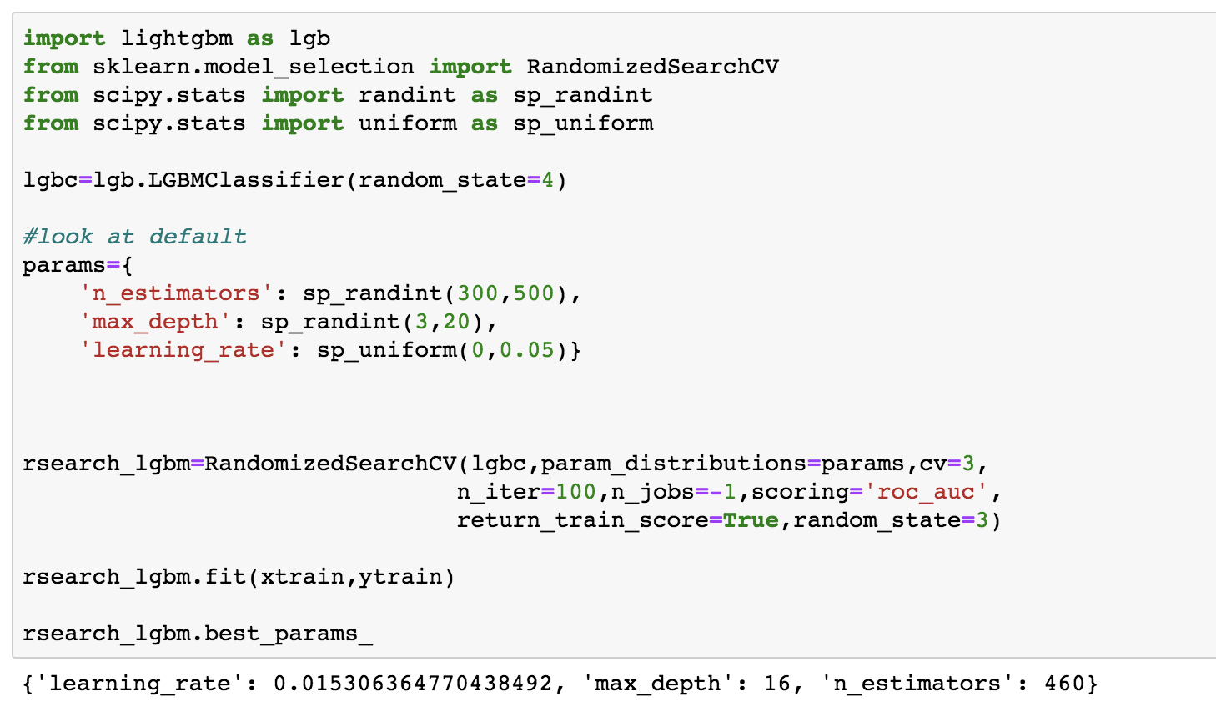
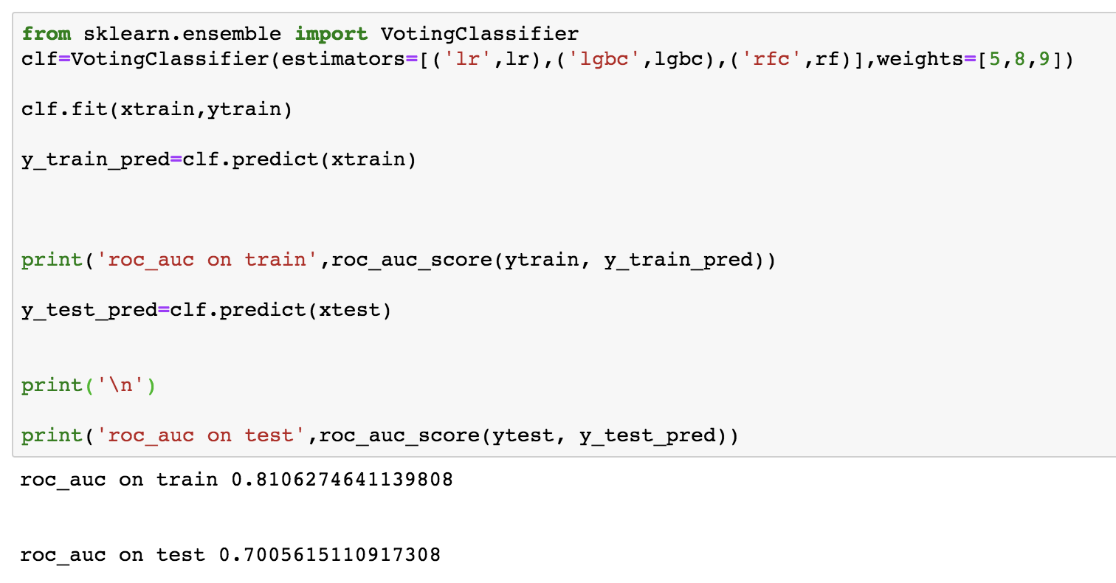
Light GBM & Ensemble
Light GBM
Ensemble

Slide 23
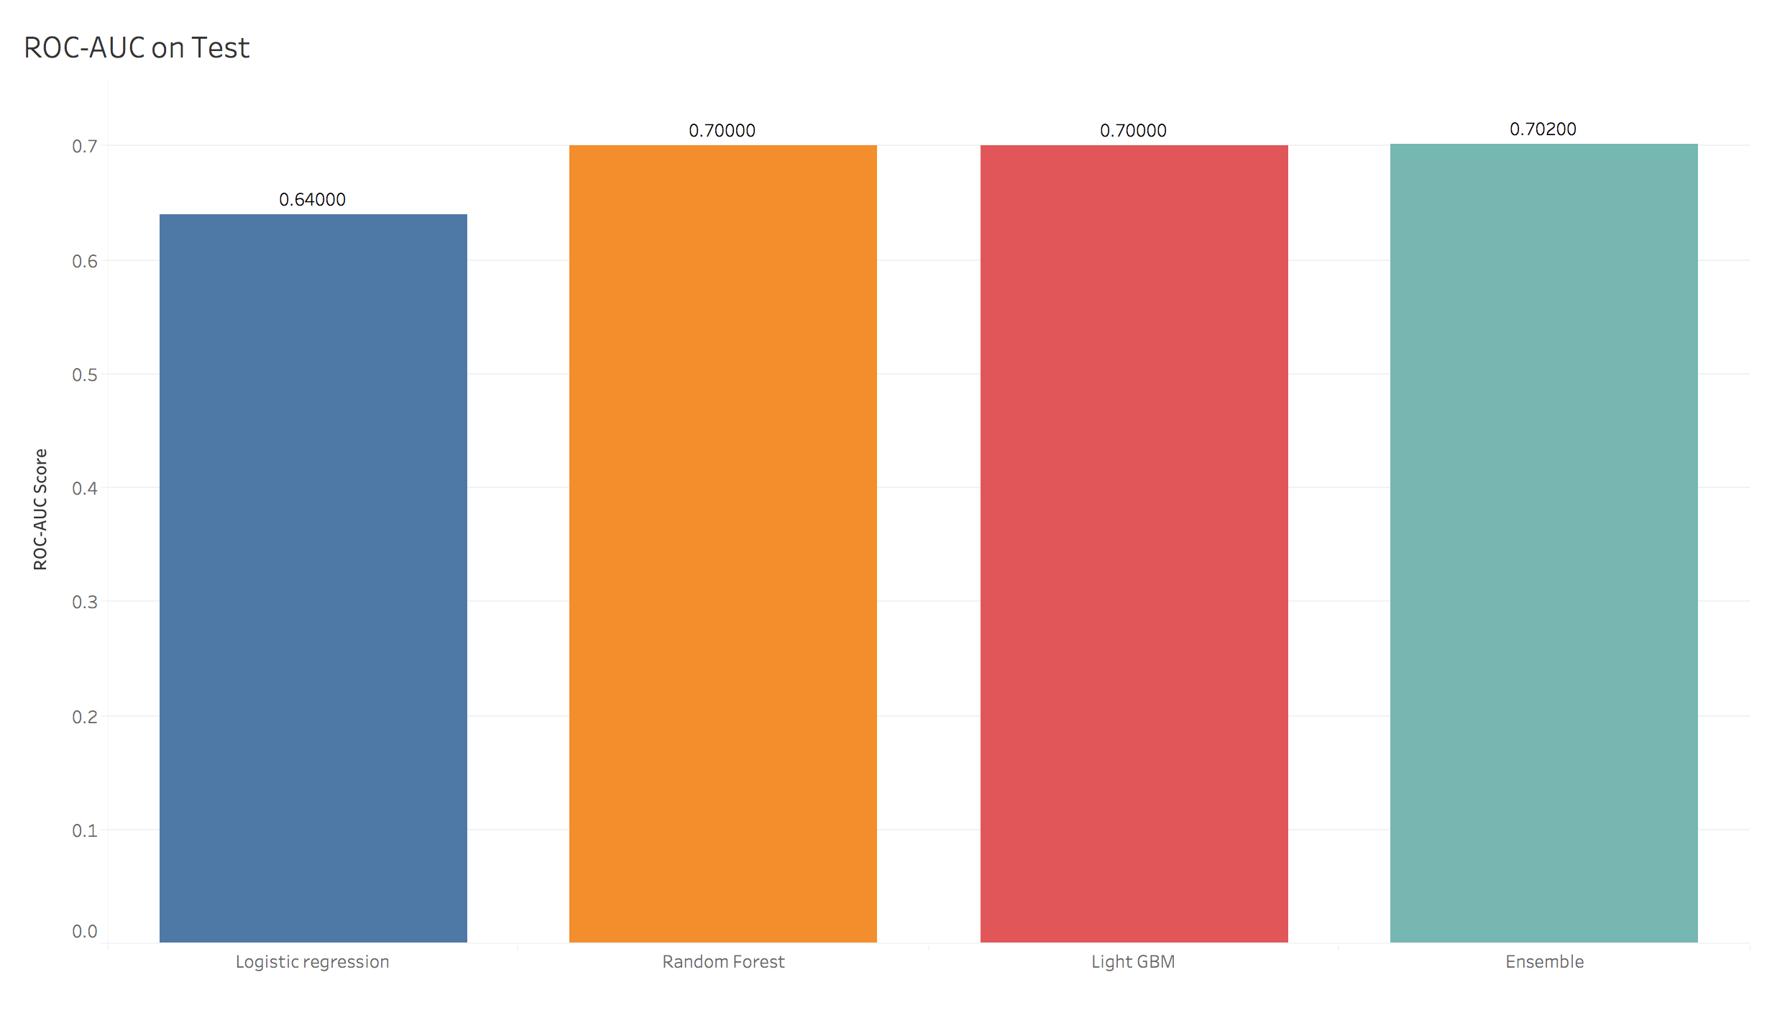
Comparison of All Models on Test Data

Slide 24
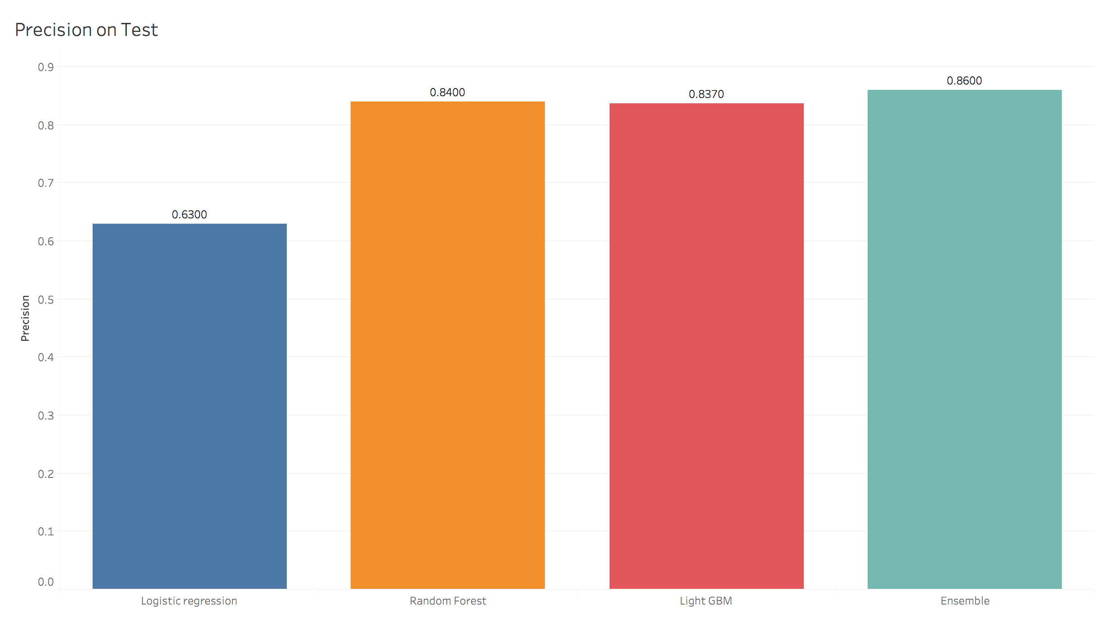
Precision of All models on Test Data
The precision score mentioned is for 0.5 threshold in logistic regression and 0.7 for remaining 3 models (for reason mentioned before)
For Ensemble model we only have 14% chance of making mistake while picking the stocks

Slide 25


